Slide 1
Matrine- CIPAC Small Scale Collaborative Study
CIPAC technical meeting 2021
Jason Zhang (Chinese Pesticide Advisory Committee, CHIPAC)
Method developed by CHENGDU NEWSUN CROP SCIENCE CO., LTD

Slide 2
BACKGROUND
Matrine is an alkaloid extracted from Sophora flavescens
Matrine is a high efficiency, broad spectrum, less resistance low toxic, low residue, environmentally friendly botanical pesticide
Matrine has been widely used on vegetables, fruits, tea, tobacco and so on.
New CIPAC method application
The method validation was conducted by Nutrichem Laboratory (Study No.: NCW-2020-146, NCW-2020-148)

Slide 3
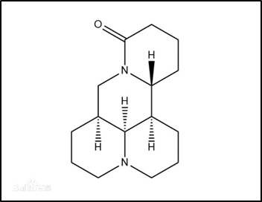
GENERAL INFORMATION
Common name | Matrine (Note:This substance is considered by ISO not to require a common name)
Chemical Name | (1R,2R,9S,17S)-7,13-diazatetracyclo[7.7.1.02,7.013,17]heptadecan-6-one
Empirical formula | C₁₅H₂₄N₂O
CAS No. | 519-02-8
Structure
RMM | 248.36
m.p. | 76-77°C
Solubility (g/L, 20℃) | In water 58 g/l, methanol and acetonitrile > 250 g/l(all at 20°C)
Description | White solid
Stability | Stable in neutral and weak acidic conditions but hydrolysed in alkaline condition
Formulation | Soluble Concentrates (SL)

Slide 4
PARTICIPANTS
Two technical concentrate samples and three SL samples were sent to the following 4 participants in February 2021.
By the end of April 2021, all 4 participants provided their results.
Lab Name | Name of responsible person | Country
School of Food and Bioengineering, Xihua University | Shan Qian | Sichuan, China
CHENGDU NEWSUN CROP SCIENCE CO., LTD | Yang Yan Qin | Sichuan, China
The Ministry of Education Key Laboratory of Standardization of Chinese Herbal Medicine, Chengdu University of Traditional Chinese Medicine | Pan Yue | Sichuan, China
Jinhua Boyue Agricultural Development Co., Ltd | Wu Liang | Zhejiang, China

Slide 5
Analytical Method
Outline of Method
The Matrine content of the samples is determined by high performance liquid chromatography on InertSustain C18 column with UV detector at 215 nm, quantified by external standard method.
Column: | Column stainless steel, Inertsustain 150mm × 4.6mm (i.d) columns, C18 packed with octadecyl silane filler (5μm), or equivalent | Eluent: | Acetonitrile /Water (0.02% Ammonium acetate + 0.02% Triethylamine) = 23/ 77(v/v)
Column Temperature: | 30℃ | Flow Rate: | 1.0 ml/min
Detector Wavelength： | 215nm | Injection Volume: | 10μL
Retention time: | Approximately 11.4min

Slide 6
Analytical Method
Preparation of the test substance solution and determination (TK)
Preparation of standard solution: Approximate 50 mg (to the nearest 0.2 mg) of analytical standard grade Matrine is weighed into a 25mL volumetric flask, dissolved and made to volume with Solution1 (500 mL Methanol and 500mL water are measured into a 1000 mL volumetric flask and mixed thoroughly as solvent used to dissolve samples) as Matrine stock standard solution. Then transfer 1.0mL of Matrine stock standard solution into a 25mL volumetric flask, dilute to volume with Solution1 and mix thoroughly to prepare Matrine standard solution. The solution should be filtered through 0.45 μm filter film before use.
Preparation of sample solution: Weigh (to the nearest 0.2mg) sufficient sample to contain about 50 mg Matrine into a 25 mL volumetric flask, dissolved and made to volume with Solution1 as sample stock solution. Then transfer 1.00mL of sample stock solution into a 25mL volumetric flask, dilute to volume with Solution1 and mix thoroughly to prepare sample solution. The solution should be filtered through 0.45 μm filter film before use.
Determination: Inject in duplicate 10μL portions of each sample solution bracketing them by injections of the calibration solutions as follows: C_{A}, S₁, S₁, C_{B}, S₂, S₂, C_{A}, etc

Slide 7
Analytical Method
Preparation of the test substance solution and determination (SL)
Preparation of sample solution: Weigh (to the nearest 0.2mg) sufficient sample to contain about 2 mg Matrine into a 25 mL volumetric flask, dissolved and made to volume with Solution1 as sample stock solution. Mix thoroughly, the solution should be filtered through 0.45 μm filter film before use.

Slide 8
Study format
Samples
Matrine Technical Concentrates (SAMPLE A)
Matrine Technical Concentrates (SAMPLE B)
Matrine Soluble Concentrates (SAMPLE C)
Matrine Soluble Concentrates (SAMPLE D)
Matrine Soluble Concentrates (SAMPLE E)
Matrine reference standard (purity 95.1 % w/w)
Protocol
The samples were analyzed on two different days, each day involving duplicate injections of duplicate weights. Test and calibration solutions were prepared fresh on each day. The sample content was calculated using the mean value of the duplicate injections.

Slide 9
Analytical conditions
Lab Number | Analytical Conditions
Laboratory 1 | Column: Inertsustain 150mm*4.6mm C18（5um） Remarks: None
Laboratory 2 | Column: Inertsustain 150mm*4.6mm C18（5um） Remarks: None
Laboratory 3 | Column: Agilient，4.6x100mm，2.7 Micron with Column ID,USCFS09415 Remarks: None
Laboratory 4 | Column: Inertsustain 150mm*4.6mm C18（5um） Remarks: None

Slide 10
DATA Evaluation and Discussion
ORINGINAL DATA (g/kg)
 | Matrine SAMPLE A |  |  |  | Matrine SAMPLE B |  |  |  | Matrine SAMPLE C
 | Day1 |  | Day2 |  | Day1 |  | Day2 |  | Day1
Laboratory 1 | 117.3 | 121.8 | 113.6 | 119.7 | 120.3 | 122.8 | 118.6 | 119.3 | 2.99 | 2.99
Laboratory 2 | 111.2 | 112.7 | 113.1 | 112.6 | 115.4 | 116.6 | 116.1 | 116.5 | 2.94 | 2.93
Laboratory 3 | 113.9 | 114.5 | 114.8 | 111.5 | 114.3 | 114.3 | 120.6 | 121.9 | 2.89 | 2.89
Laboratory 4 | 112.5 | 113.0 | 113.0 | 112.0 | 116.6 | 116.5 | 115.9 | 115.7 | 2.92 | 2.90

Slide 11
 | Matrine SAMPLE C |  | Matrine SAMPLE D |  |  |  | Matrine SAMPLE E
 | Day2 |  | Day1 |  | Day2 |  | Day1 |  | Day2
Laboratory 1 | 2.93 | 2.94 | 3.10 | 3.07 | 2.93 | 2.94 | 3.53 | 3.53 | 3.48 | 3.47
Laboratory 2 | 2.96 | 2.95 | 2.99 | 2.98 | 2.99 | 2.97 | 3.55 | 3.56 | 3.57 | 3.58
Laboratory 3 | 2.85 | 2.86 | 2.91 | 2.90 | 2.85 | 2.85 | 3.46 | 3.46 | 3.51 | 3.40
Laboratory 4 | 2.91 | 2.91 | 2.95 | 2.95 | 2.96 | 2.96 | 3.52 | 3.53 | 3.52 | 3.52

Slide 12
DATA EVALUATION AND DISCUSSION
MEAN VALUES (g/kg)
 | Matrine SAMPLE A | Matrine SAMPLE B | Matrine SAMPLE C | Matrine SAMPLE D | Matrine SAMPLE E
Laboratory 1 | 118.1 ⁺ | 120.3 | 2.97 | 3.02 | 3.51
Laboratory 2 | 112.4 | 116.2 | 2.94 | 2.99 | 3.57
Laboratory 3 | 113.7 | 117.8 | 2.88 | 2.88 | 3.46
Laboratory 4 | 112.6 | 116.2 | 2.91 | 2.96 | 3.53
⁺ Gubbs Test straggler

Slide 13
DATA Evaluation and Discussion
Xm | 114.2
L | 4
Sr | 1.971
S_{R} | 3.159
r | 5.519
R | 8.845
RSDr | 1.726
RSDR | 2.767
RSDR(Hor) | 2.772
HorRat | 0.998
Fig. 1 – Matrine Sample A with stragglers

Slide 14
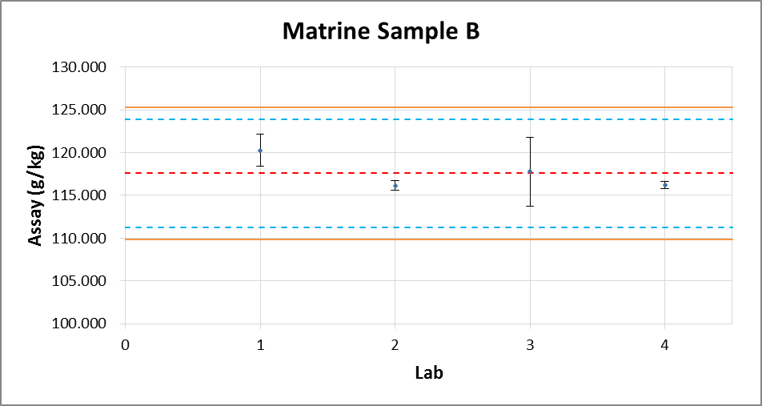
Xm | 117.6
L | 4
Sr | 2.250
S_{R} | 2.743
r | 6.300
R | 7.680
RSDr | 1.914
RSD_{R} | 2.333
RSD_{R}(Hor) | 2.760
HorRat | 0.845
Fig. 2 – Matrine Sample B

Slide 15
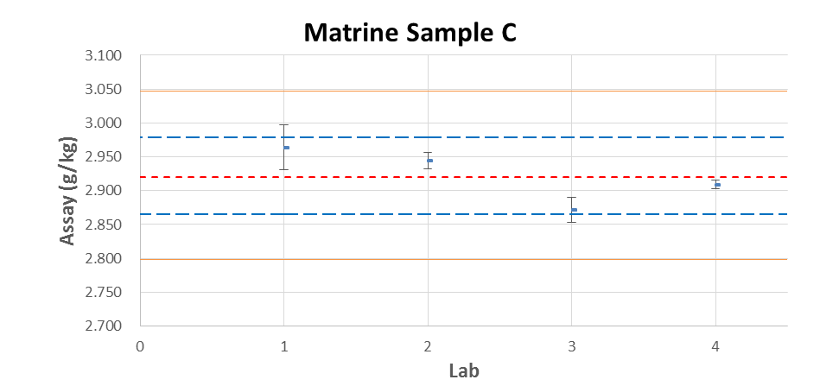
Xm | 2.923
L | 4
Sr | 0.02051
S_{R} | 0.04362
r | 0.05880
R | 0.12214
RSDr | 0.70194
RSD_{R} | 1.493
RSD_{R}(Hor) | 4.814
HorRat | 0.310
Fig. 3 – Matrine Sample C

Slide 16
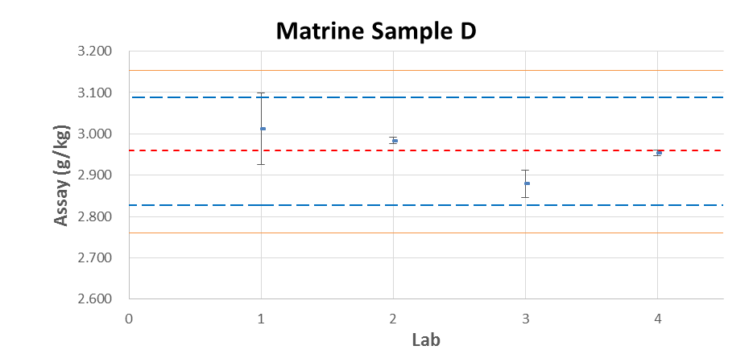
Xm | 2.956
L | 4
Sr | 0.04695
S_{R} | 0.07010
r | 0.13146
R | 0.19628
RSDr | 1.5881
RSD_{R} | 2.371
RSD_{R}(Hor) | 4.805
HorRat | 0.493
Fig. 4 – Matrine Sample D

Slide 17
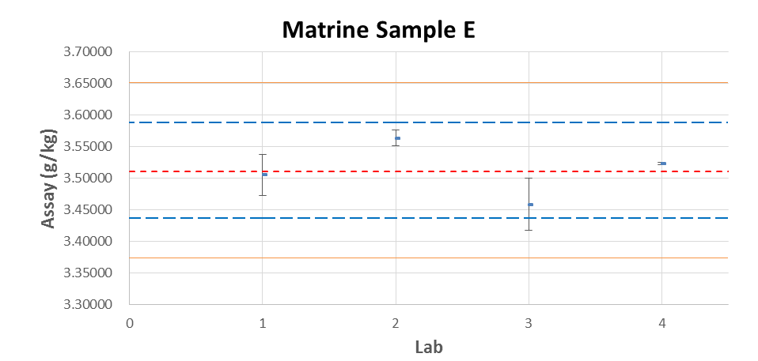
Xm | 3.512
L | 4
Sr | 0.02847
S_{R} | 0.05100
r | 0.07972
R | 0.14280
RSDr | 0.81062
RSD_{R} | 1.452
RSD_{R}(Hor) | 4.682
HorRat | 0.310
Fig. 5 – Matrine Sample E

Slide 18
Summary
Summary of the statistical evaluation with outliers /stragglers
 | sample A | sample B | sample C | sample D | sample E
Xm | 114.2 | 117.6 | 2.923 | 2.956 | 3.512
L | 4 | 4 | 4 | 4 | 4
Sr | 1.971 | 2.250 | 0.02051 | 0.04695 | 0.02847
S_{R} | 3.159 | 2.743 | 0.04362 | 0.07010 | 0.05100
r | 5.519 | 6.300 | 0.05880 | 0.13146 | 0.07972
R | 8.845 | 7.680 | 0.12214 | 0.19628 | 0.14280
RSDr | 1.726 | 1.914 | 0.70194 | 1.5881 | 0.81062
RSD_{R} | 2.767 | 2.333 | 1.493 | 2.371 | 1.452
RSD_{R}(Hor) | 2.772 | 2.760 | 4.814 | 4.805 | 4.682
HorRat | 0.998 | 0.845 | 0.310 | 0.493 | 0.310
Xm = average
L = number of laboratories
S_{r} = repeatability standard deviation
S_{R} = reproducibility standard deviation
RSD_{r} = repeatability relative standard deviation
RSD_{R} = reproducibility relative standard deviation
r = repeatability
R = reproducibility
RSD_{R} (Hor) = Horwitz value calculated from: 2^(1 - 0.5log c) where c = the concentration of the analyte as a decimal fraction

Slide 19
Summary of the statistical evaluation without stragglers
 | sample A | sample B | sample C | sample D | sample E
Xm | 112.9 | 117.6 | 2.923 | 2.956 | 3.512
L | 3 | 4 | 4 | 4 | 4
Sr | 1.026 | 2.250 | 0.02051 | 0.04695 | 0.02847
S_{R} | 1.119 | 2.743 | 0.04362 | 0.07010 | 0.05100
r | 2.873 | 6.300 | 0.05880 | 0.13146 | 0.07972
R | 3.133 | 7.680 | 0.12214 | 0.19628 | 0.14280
RSDr | 0.909 | 1.914 | 0.70194 | 1.5881 | 0.81062
RSD_{R} | 0.991 | 2.333 | 1.493 | 2.371 | 1.452
RSD_{R}(Hor) | 2.777 | 2.760 | 4.814 | 4.805 | 4.682
HorRat | 0.357 | 0.845 | 0.310 | 0.493 | 0.310
Xm = average
L = number of laboratories
S_{r} = repeatability standard deviation
S_{R} = reproducibility standard deviation
RSD_{r} = repeatability relative standard deviation
RSD_{R} = reproducibility relative standard deviation
r = repeatability
R = reproducibility
RSD_{R} (Hor) = Horwitz value calculated from: 2^(1 - 0.5log c) where c = the concentration of the analyte as a decimal fraction
Sample A Results of Lab 1 eliminated

Slide 20
conclusions
For all samples, the values of RSD_{R} (reproducibility relative standard deviation) were less than Horwitz’s value. As a reference, all HorRat values were not greater than 1.0. The proposed method is considered to be appropriate for the determination of Matrine in technical concentrates and SL formulation.
Based on the results of small scale collaborative study, this method is proposed to proceed with a large scale collaborative study.

Slide 21
Thanks for your attention!

